Slide 1

La Kopi: Forging of the Chinese Singaporean Community
GES1038

Slide 2
Admin matters

Slide 3
1 hr 35 mins of online lessons

Slide 6
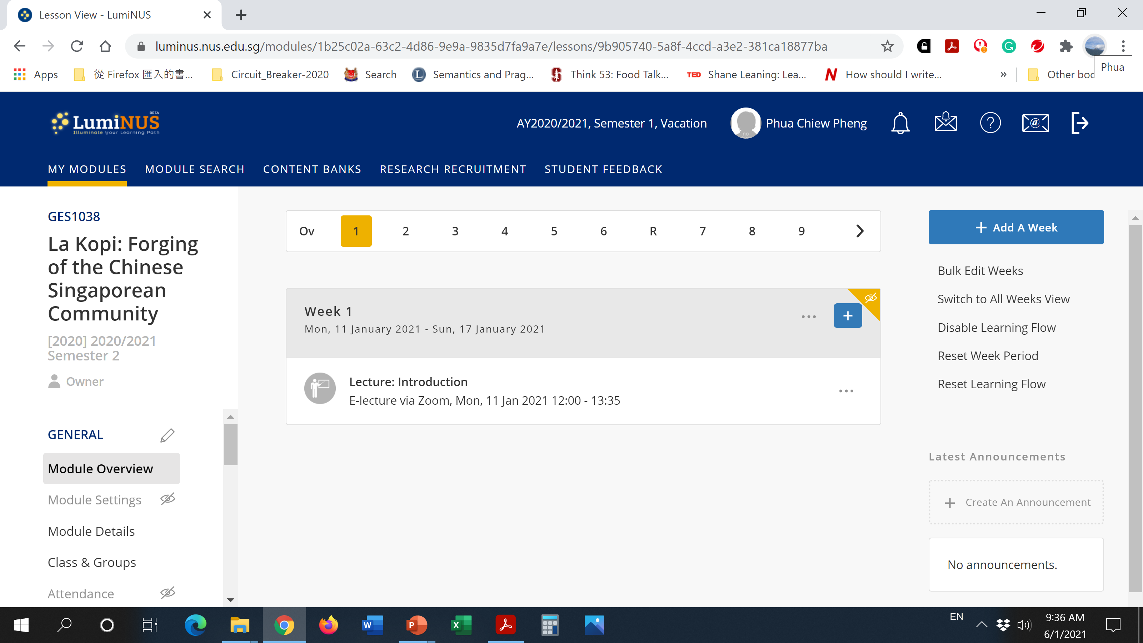

Slide 7
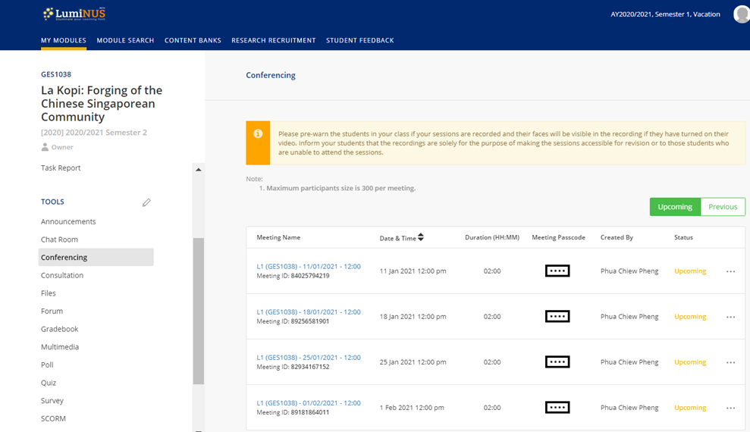

Slide 8
La Kopi: Forging of the Chinese Singaporean Community
GES1038

Slide 9
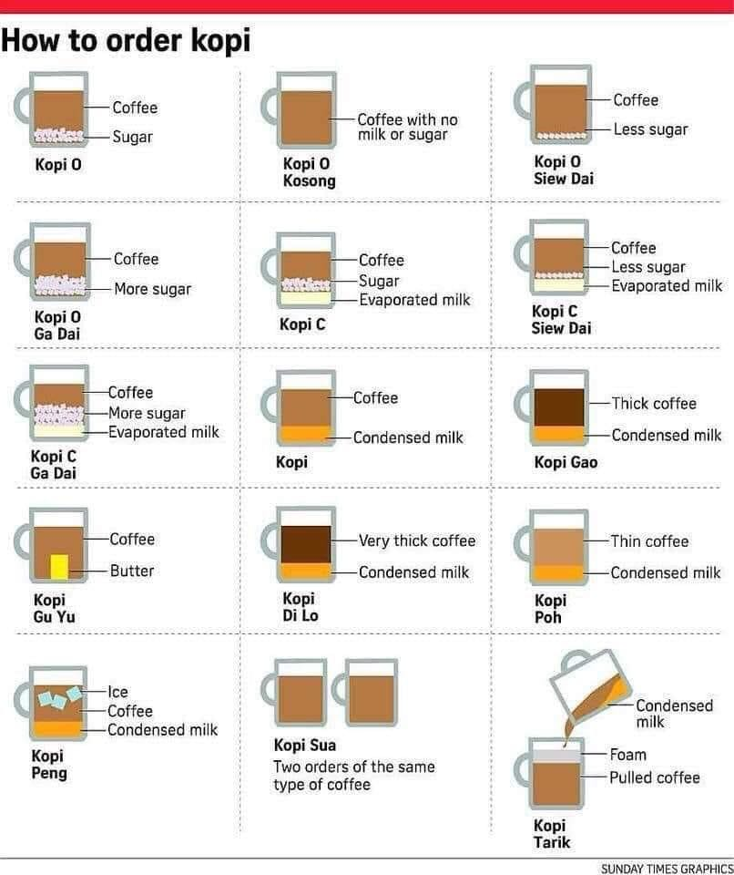

Slide 10
CA 100%
Tutorial participation – 20%
Group presentation?
Critical review (due 15 March 2021, before 12 pm) - 20%
Word limit: 1000 words
Individual research essay (due 19 April 2021, before 12 pm) – 40%
The topic will revolve around __________________________
Word limit: 2000 words
Final Quiz (12 April 2021) - 20%
Open book quiz
________________________

Slide 11
GE modules in NUS
GEH-Human Cultures pillar
GEQ-Asking Questions pillar
GER-Quantitative Reasoning pillar
GES-Singapore Studies pillar
GET-Thinking and Expression pillar
Singapore Studies aims to strengthen a student's understanding of the economy, geography, history, politics, and society of Singapore. The modules are designed to expose students to different perspectives on the critical issues confronting Singapore, and a deep appreciation of the conditions affecting decision-making in a Singapore operating within a regional and global context.

Slide 13
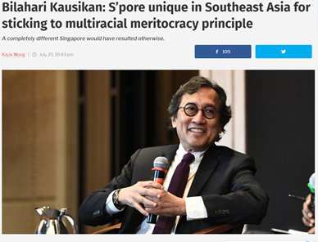

Slide 14
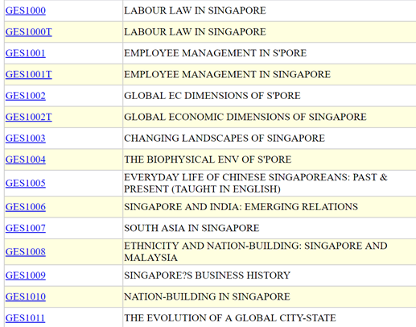
GES modules in NUS

Slide 15
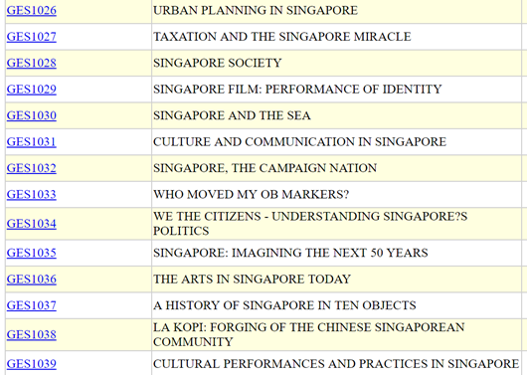

Slide 19

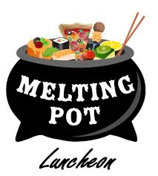
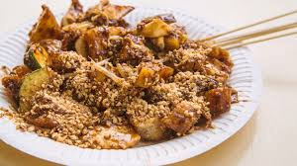

Slide 21
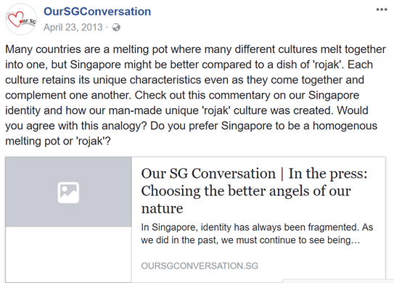

Slide 22
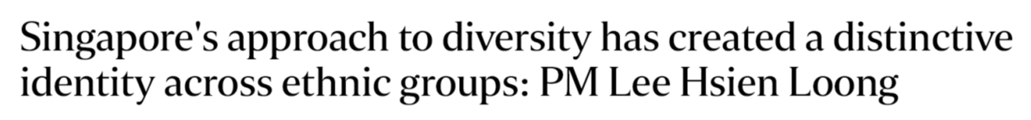
Singapore is not a melting pot, but a society where each race is encouraged to preserve its unique culture and traditions, and appreciate and respect that of others, Prime Minister Lee Hsien Loong said on Friday (May 19).
Notes:
Multiculturalism can be defined as a demographic make-up of a country where various cultural divisions are accepted for the sake of diversity.
A melting pot, on the other hand, is a society where all of the people blend together to form one basic cultural norm based on the dominant culture.

Slide 24
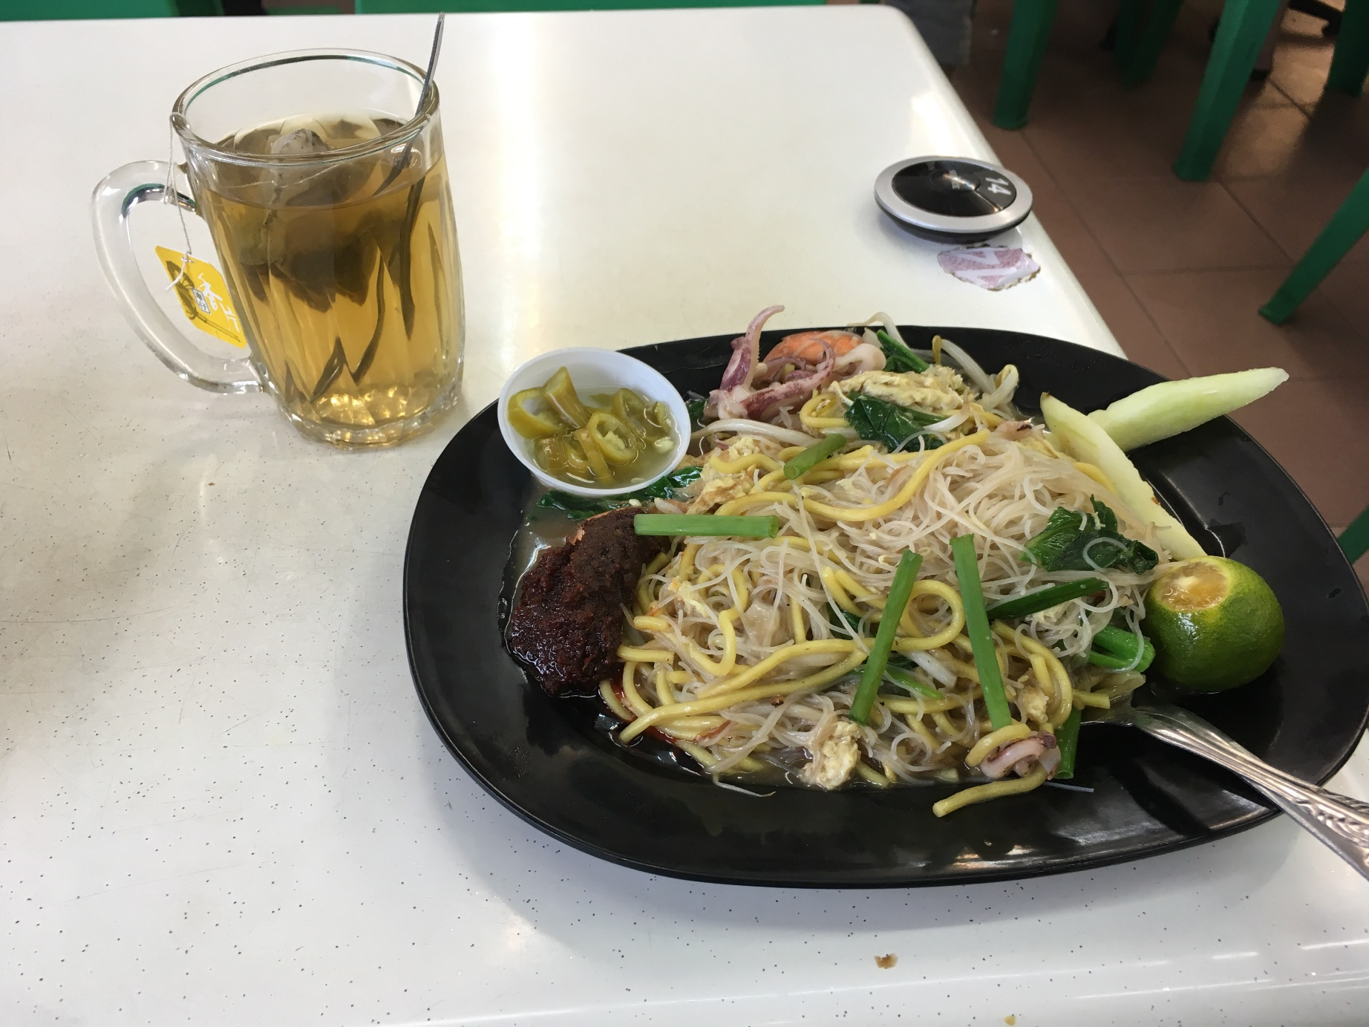

Slide 27
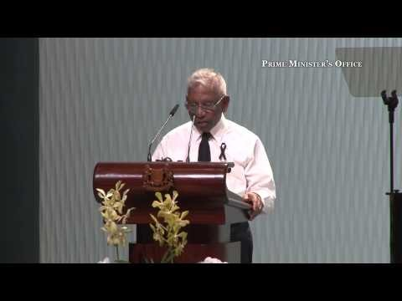
Notes:
3:38

Slide 28
Idealism
The last point concerns his reputation as the complete political pragmatist who did not allow idealism to get in the way of what would work in and for Singapore. He was a pragmatist, yet in a very deep sense he was an idealist. He was obsessed with not only what would work in Singapore, but what the feel and timbre of our society should be. This is well illustrated by his approach to the language policy. In a population comprising 75% Chinese, the easiest way to ensure political support and electoral support would have been to champion Chinese language and, behind that, Chinese chauvinism.
He was convinced that for our nation to be distinct and different from other nations we had to be multi-lingual with English as the main language of administration and commerce. But each racial group must maintain its cultural identity with their mother tongue as a second language. To convert Chinese schools into national type schools and push for Mandarin against Chinese dialects were the acts of an idealist not the acts of a pragmatist.

Slide 30
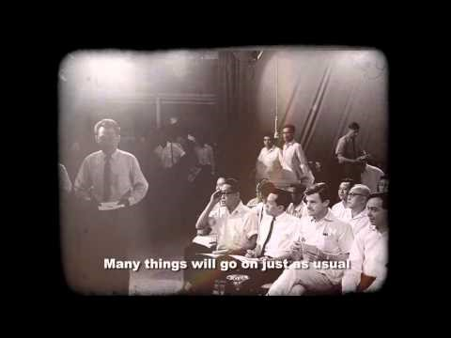
Notes:
1:20mins

Slide 31
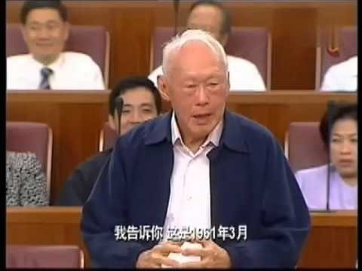

Slide 32
In the words of Mr. Lee Kuan Yew
When we became independent in 1965, the Chinese Chamber of Commerce committee came to see me in my office, then at City Hall. They urged me to have Chinese as our national and official language. I looked them in the eye and said, "You must be mad, and I don't want to hear any more of that from you. If you do, you are entering the political arena. I have to fight you. Because Singapore will come apart."

Slide 35
A Chinese island in a Malay sea
Singapore's elder statesman, Lee Kuan Yew, ends the first volume of his autobiography (Lee, 1998: 667) with a map of this region, to which the caption is 'We were a Chinese island in a Malay sea. How could we survive in such a hostile environment?'

Slide 36
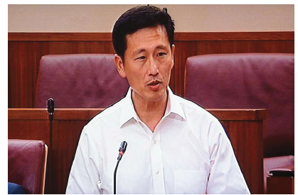
The Chinese community, which makes up the majority in Singapore, has always acted in the interests of the wider society, Education Minister (Higher Education and Skills) Ong Ye Kung said yesterday in Parliament.
One example of the community compromising was when it agreed to have English as the state's working language, he added.

Slide 37
Chineseness in Singapore

Slide 38
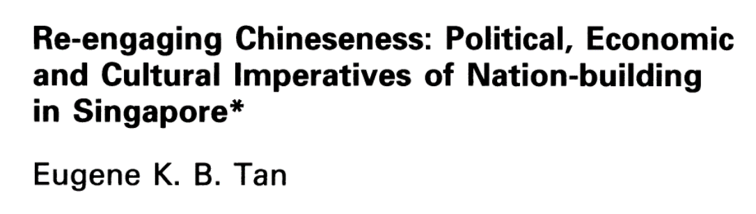
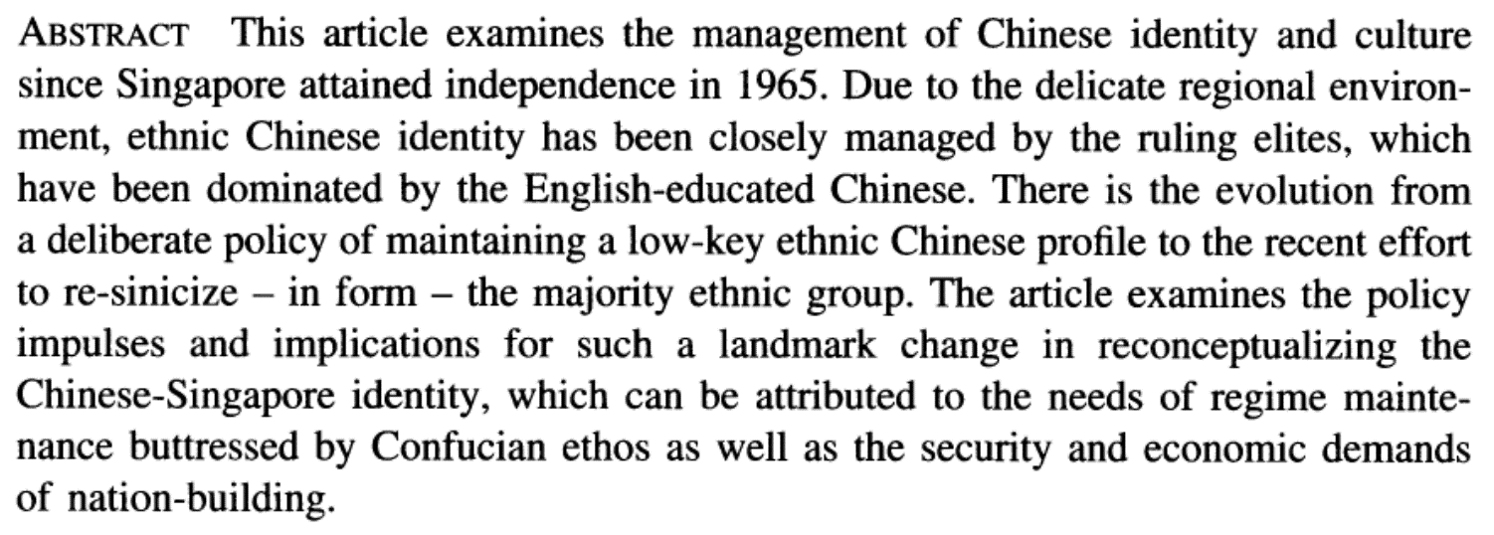

Slide 39
Chinese educated vs English educated

Slide 40
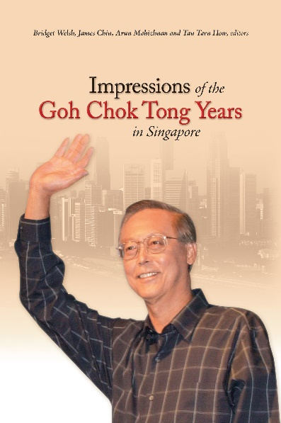

Slide 43
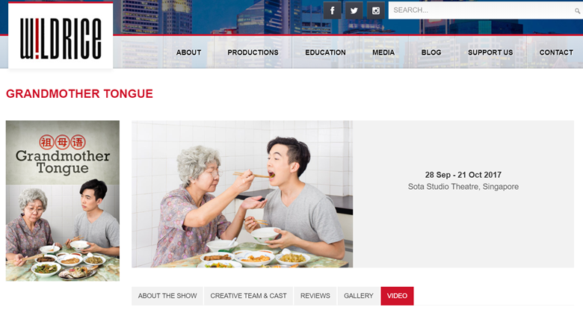
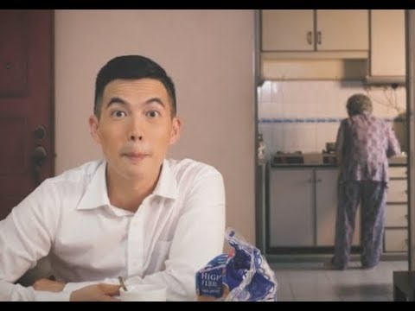

Slide 44
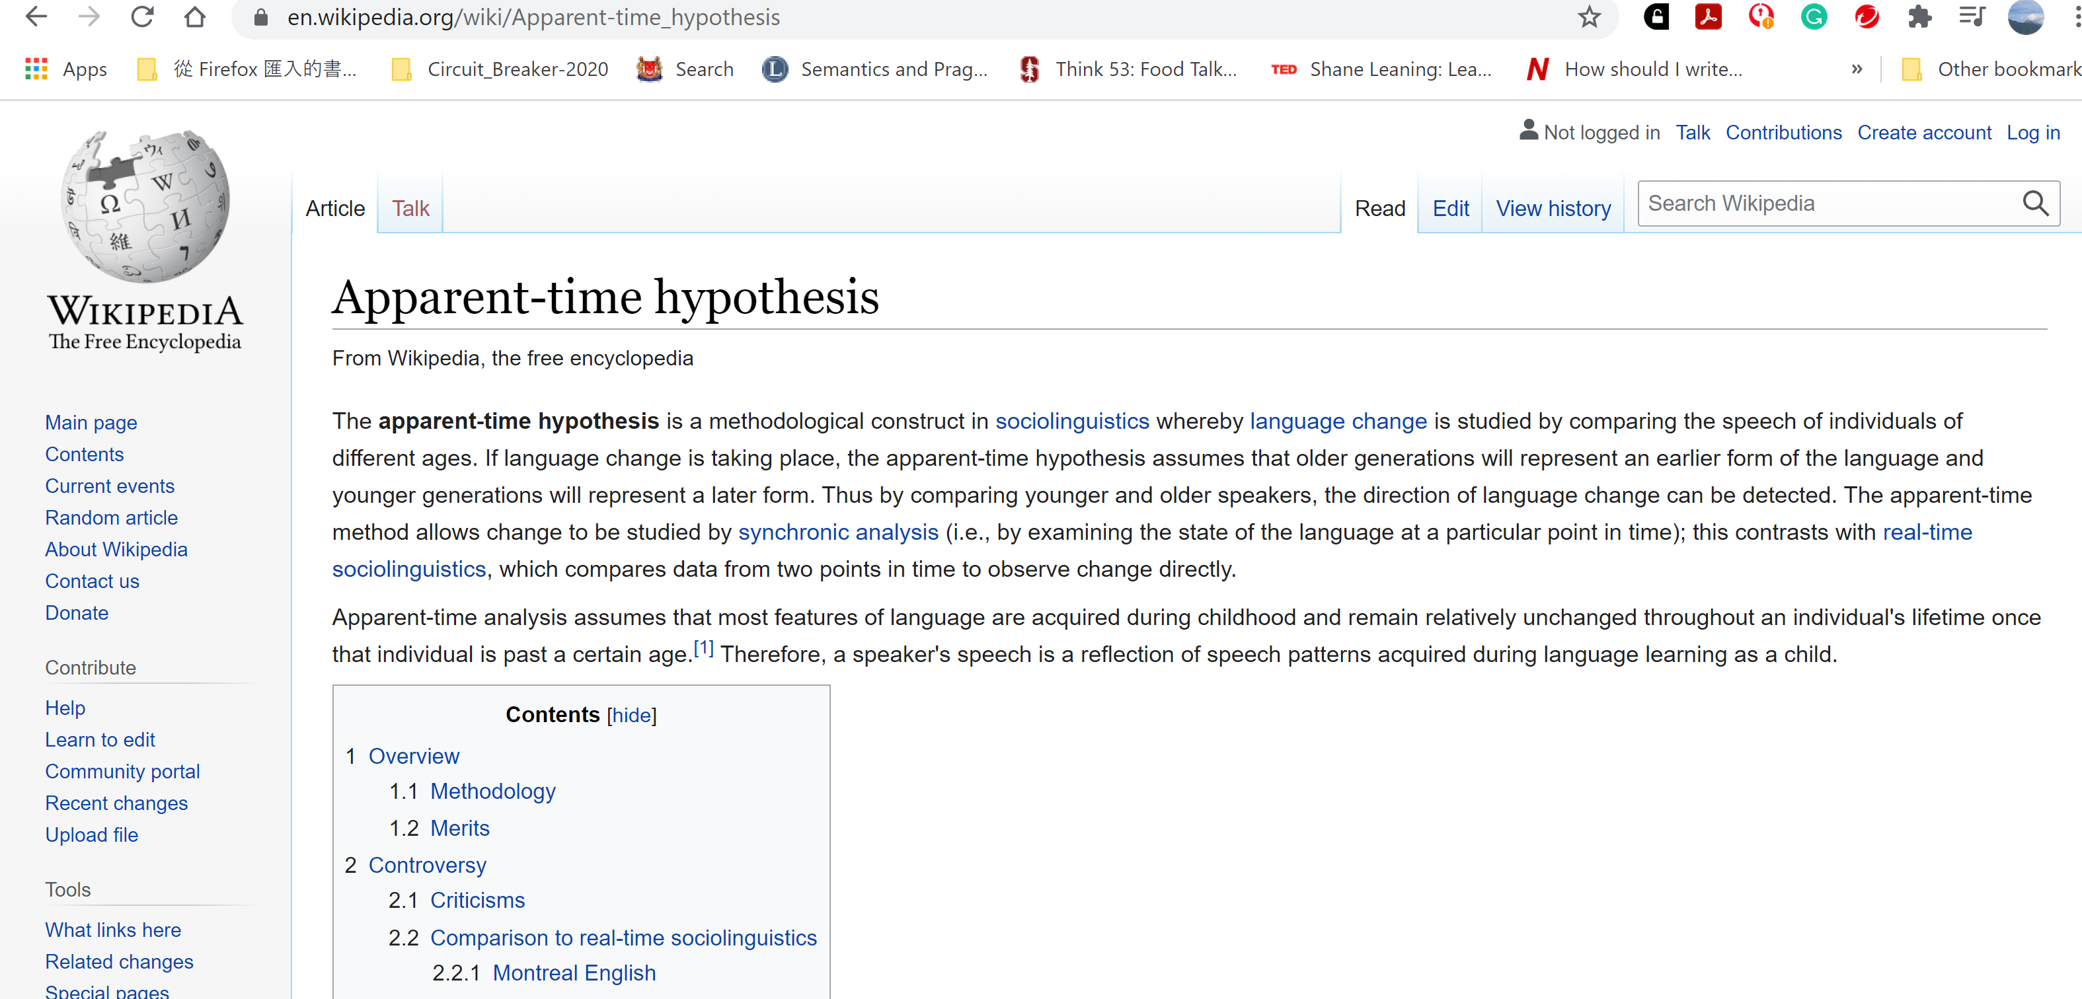
Apparent time

Slide 45
Historically, this is definitely not true.

Slide 50
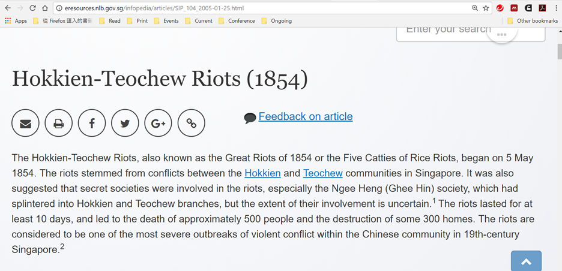

Slide 51
Remnants of the past ……

Slide 52
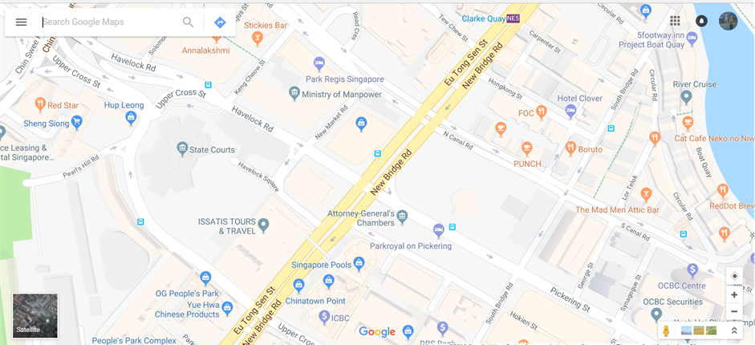

Slide 53
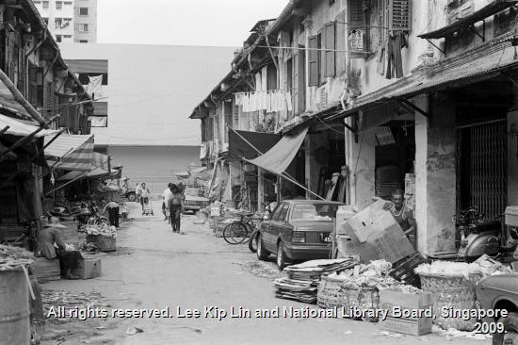
Chin Hin Street

Slide 54
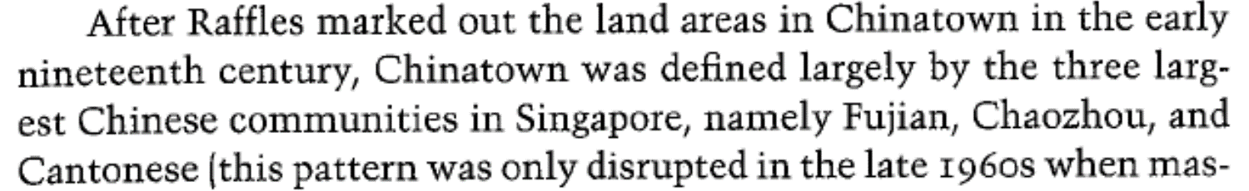

Slide 56
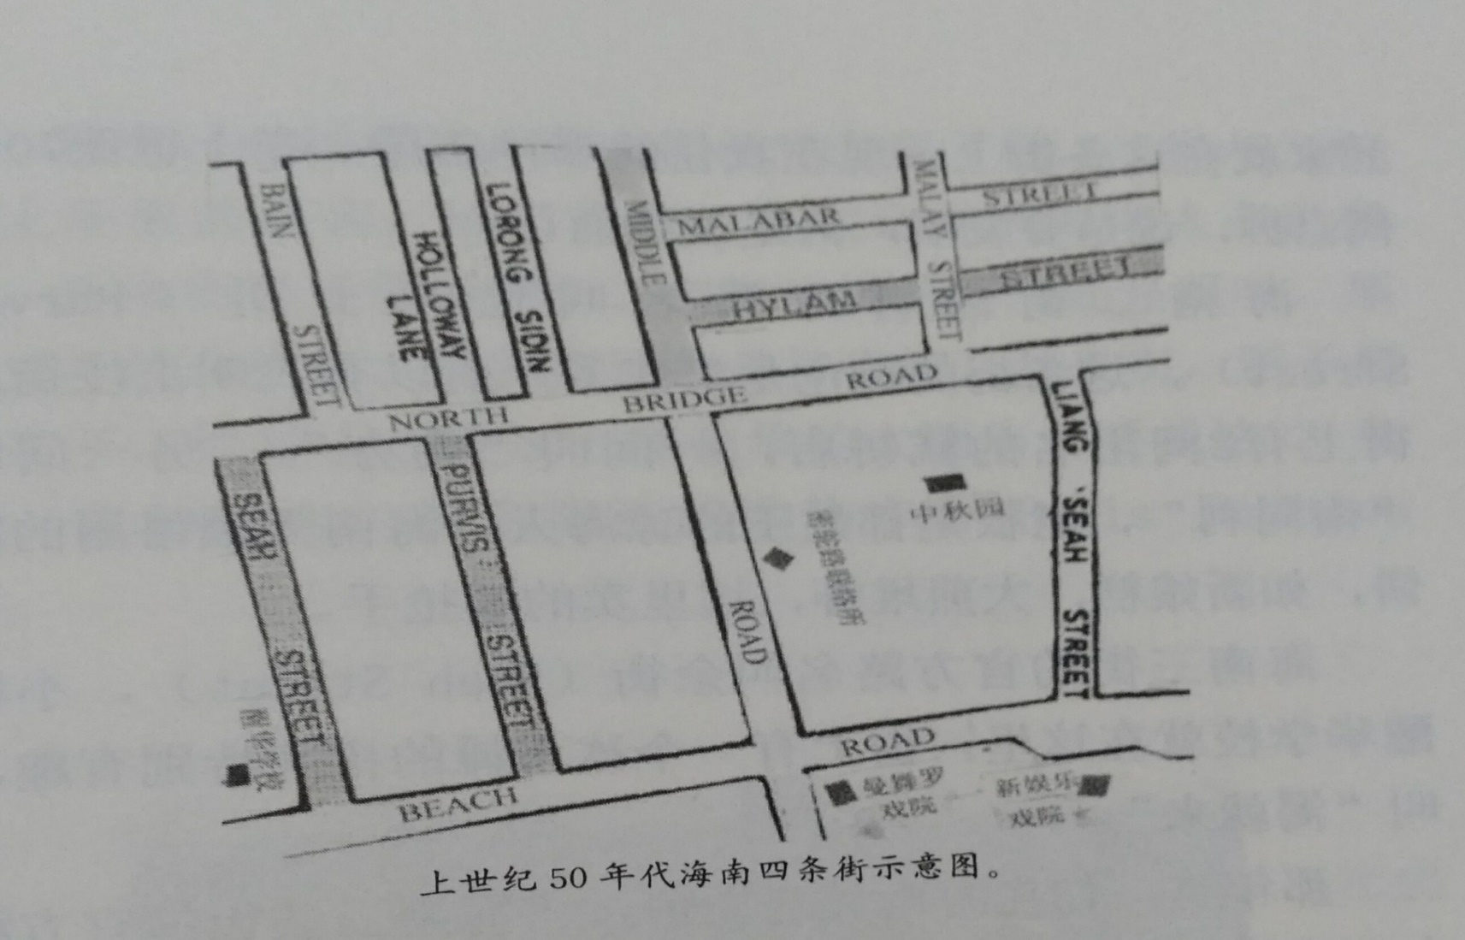
Hainanese Community

Slide 57
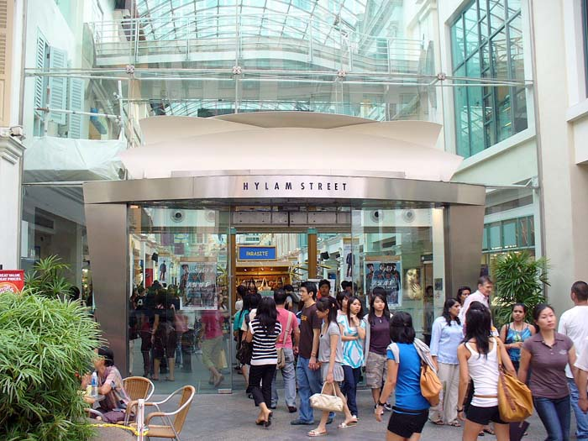

Slide 58
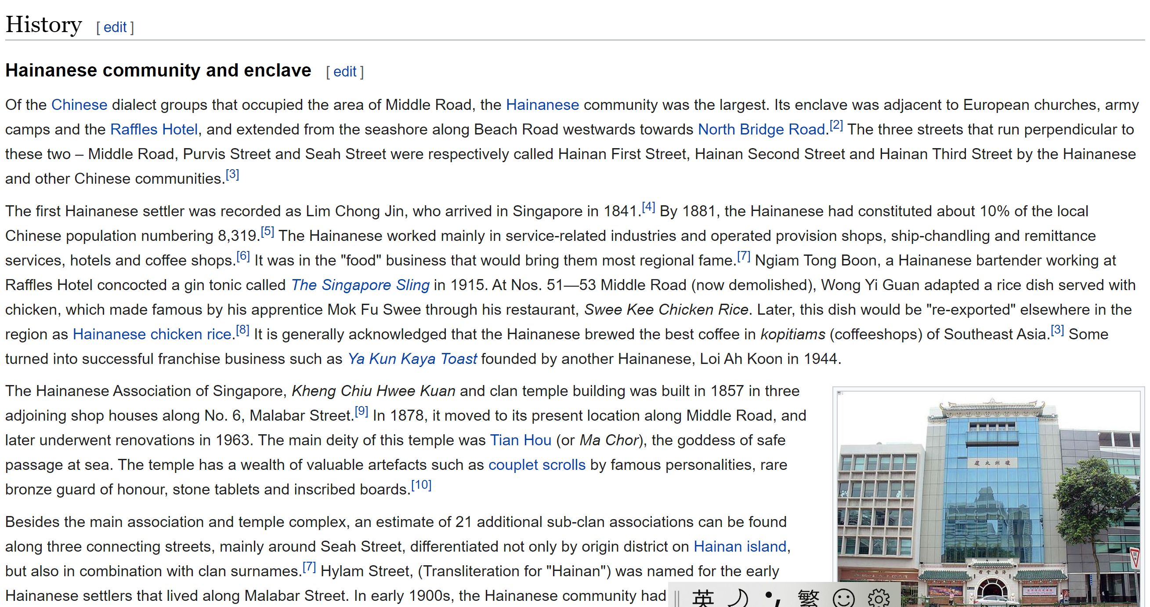

Slide 59
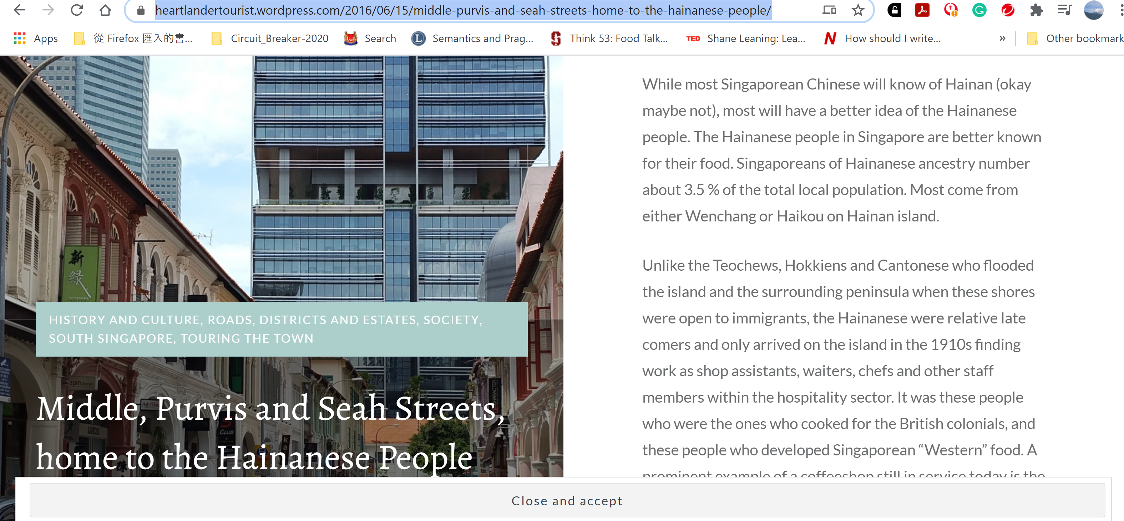

Slide 60
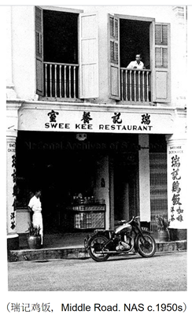

Slide 61
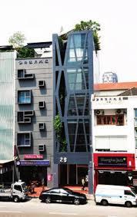

Slide 62
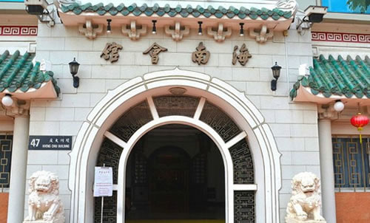

Slide 65
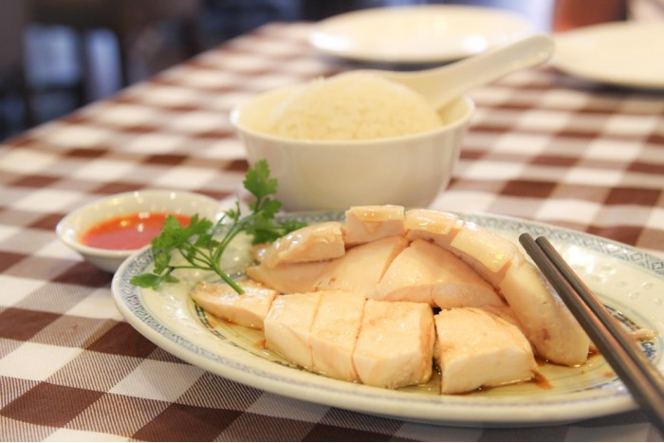

Slide 66
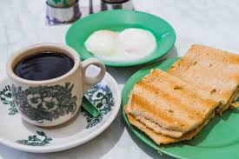

Slide 67
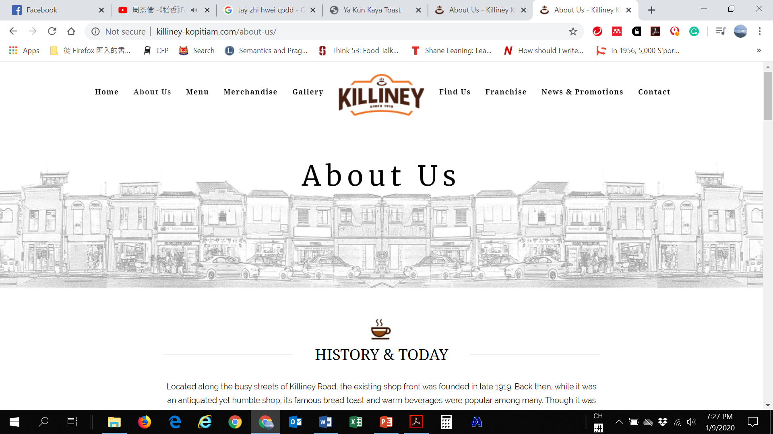
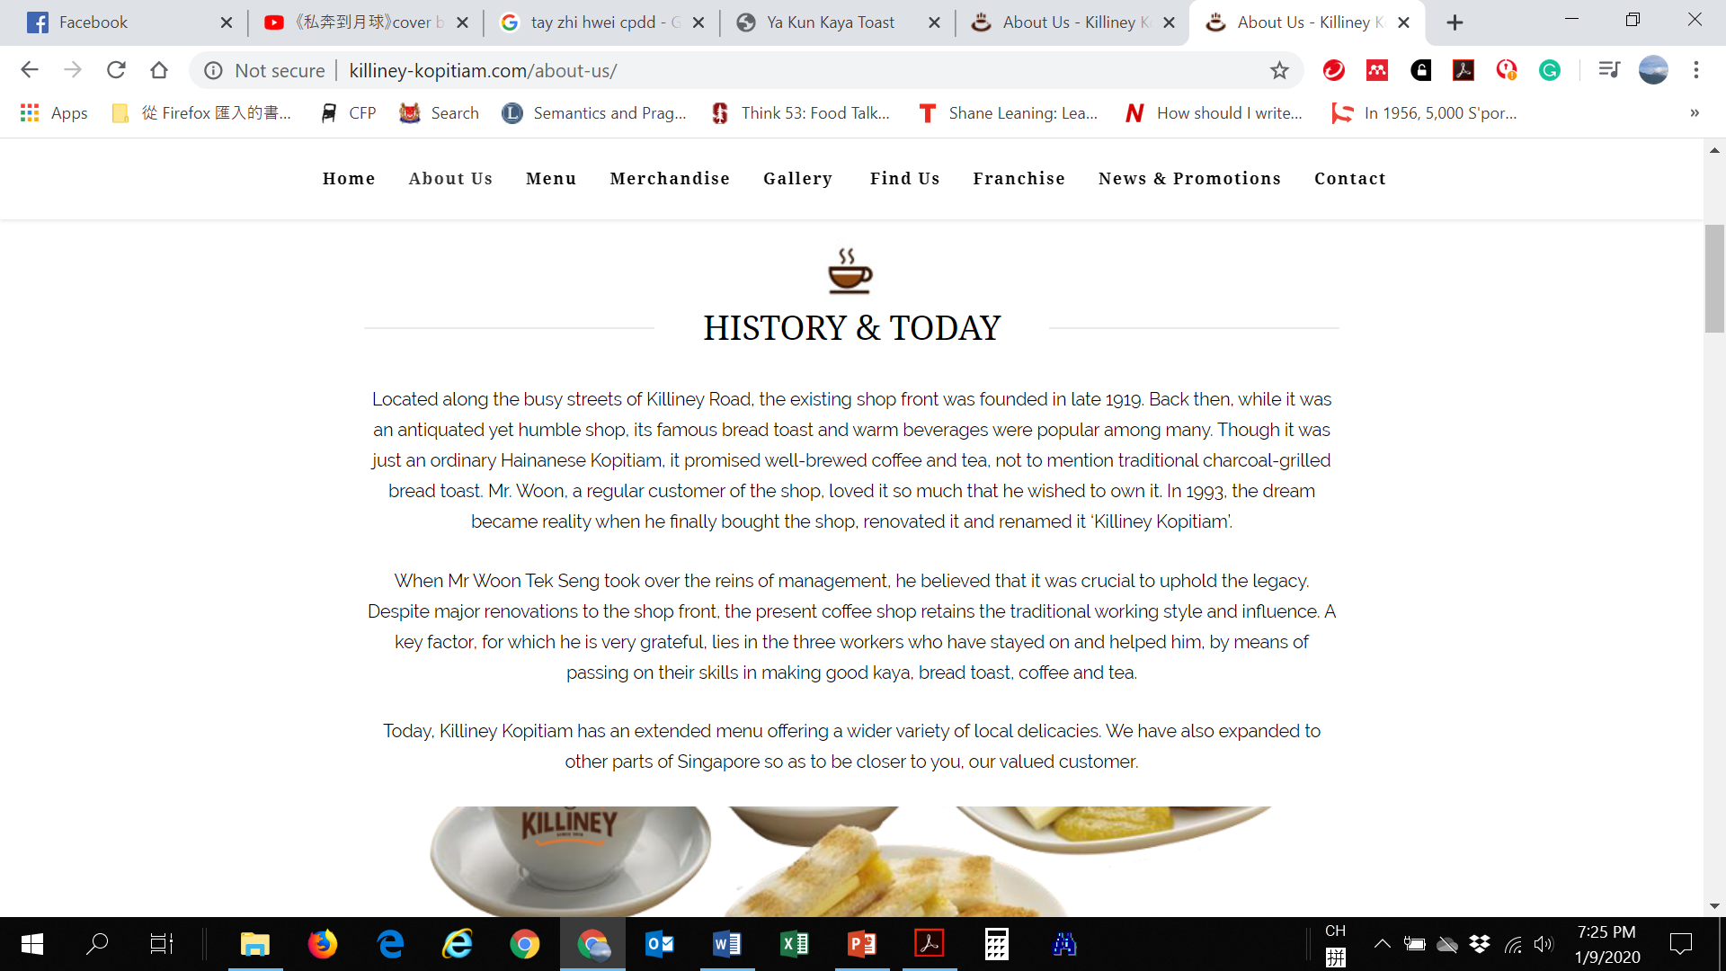

Slide 68
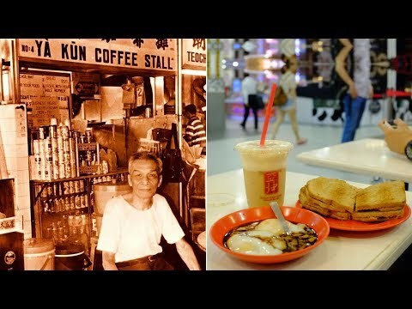

Slide 69
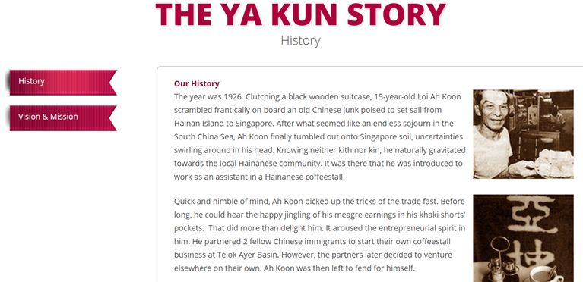

Slide 70
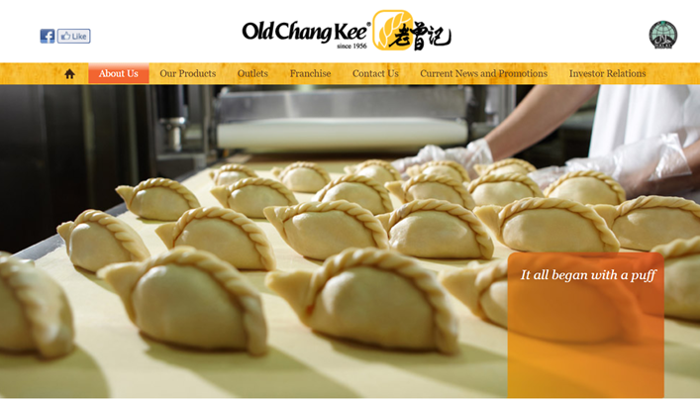

Slide 71
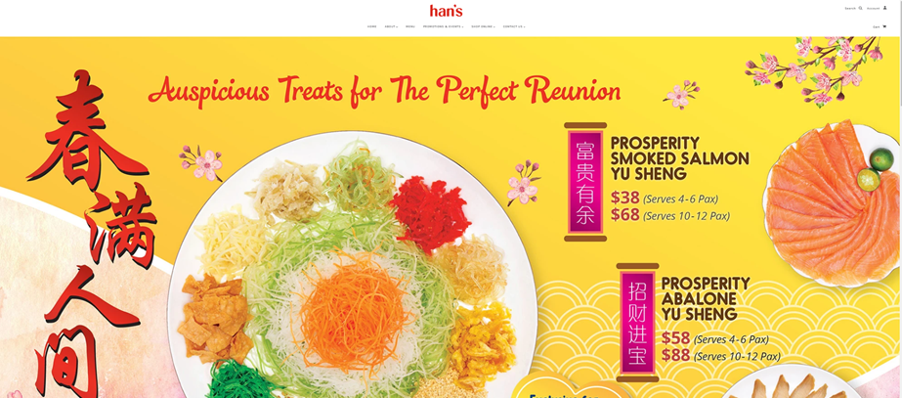

Slide 72
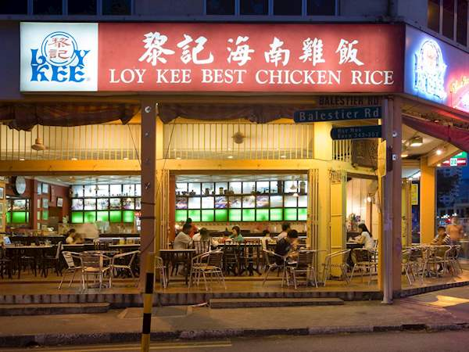

Slide 73


Slide 74
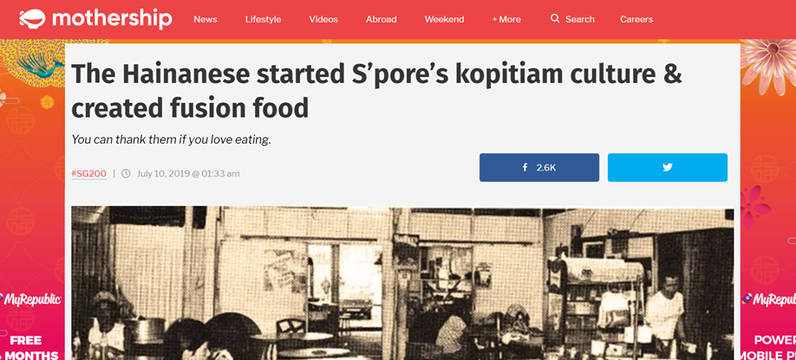

Slide 76
Coffee Shops Hainanese vs Foochow
In the postwar period. More than eighty per cent of the coffee-shops in Singapore were owned by Hainanese and Foochows. Both were migrant Chinese groups from mainland China, who entered the coffee-shop business as a response to difficulties in obtaining employment. By the 1950s there were reportedly more than 2,000 Hainanese and Foochow coffee-shops throughout Singapore.¹⁸
¹⁸ ‘They Fear these Hawkers’, Singapore Free Press, 22 Jan. 1953

Slide 77
Which dialect group dominates the tea trade in Singapore?

Slide 78
AND ……

Slide 79
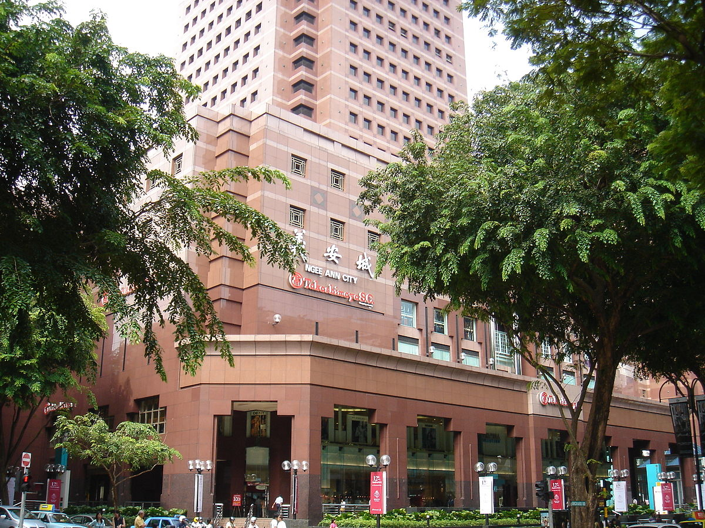

Slide 80
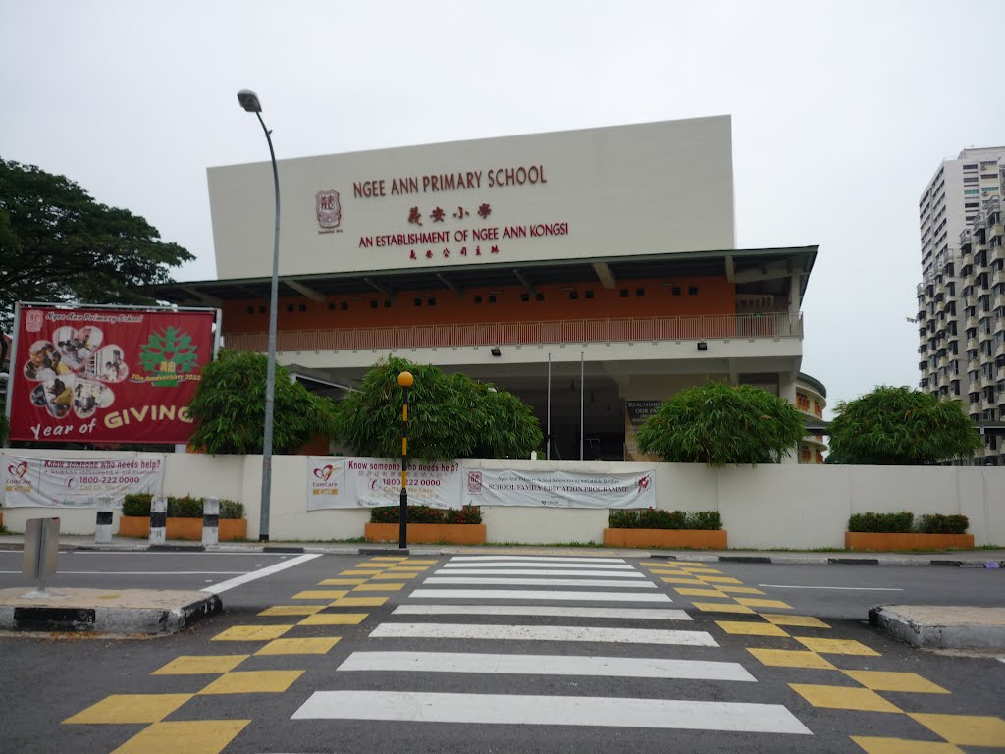

Slide 81
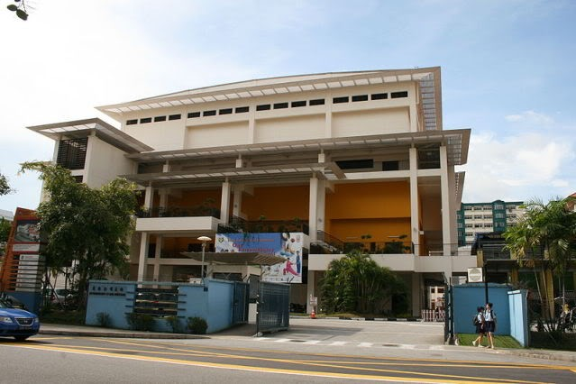

Slide 82
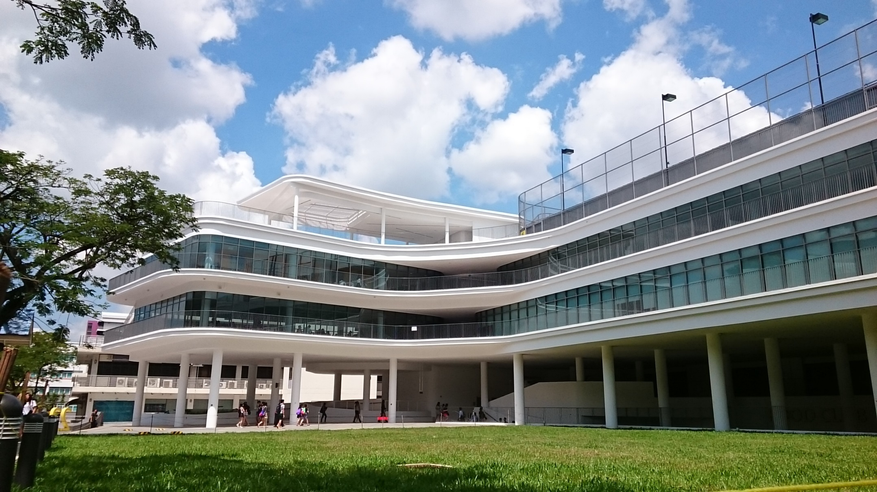
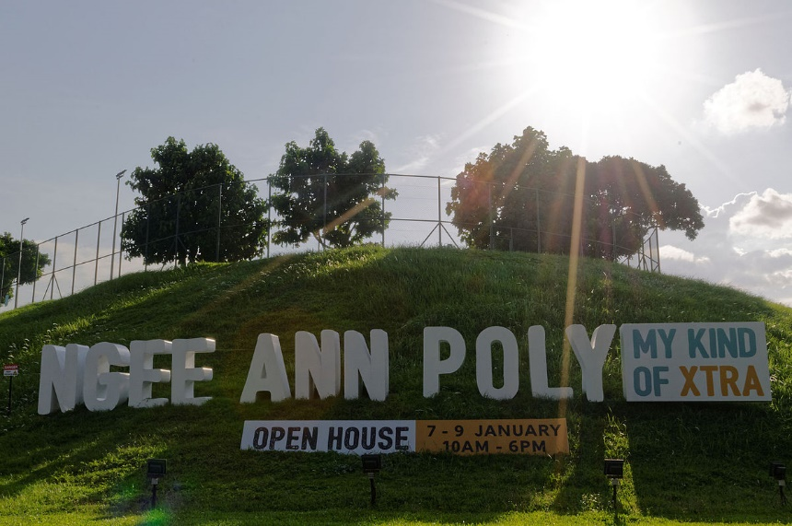

Slide 83
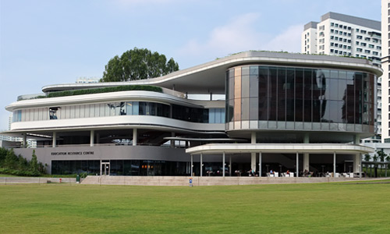

Slide 84
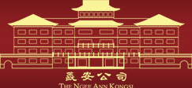

Slide 85
Ngee Ann Kongsi
The Ngee Ann Kongsi, a charitable association representing the Chinese Teochew community, was incorporated in 1845.

Slide 87


Slide 88
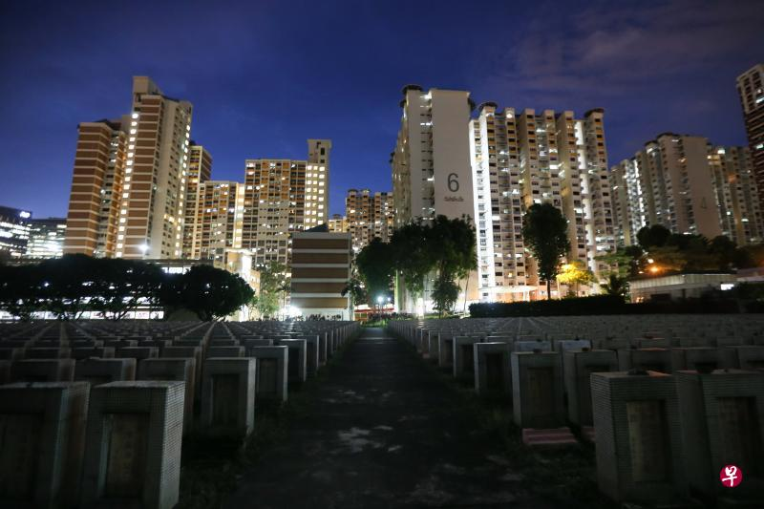

Slide 89


Slide 90



Slide 91


Kwong Wai Siew Peck San Theng was originally a cemetery in Singapore that was established in 1870 by Cantonese and Hakka immigrants largely from the three prefectures of Guangzhou, Huizhou and Zhaoqing in Guangdong Province, China.

Slide 92
Hokkien?

Slide 93


Slide 94
Identify another two further assumptions made in our earlier discussion?

Slide 95
We will reveal the answer next week.

